Slide 1

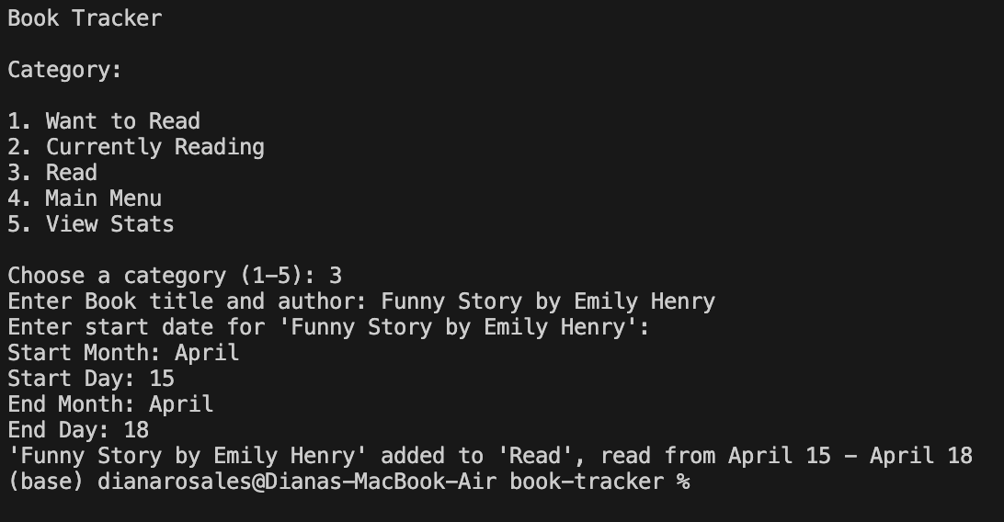
Book Tracker
Coder: Diana Rosales
Example output:
Example Output:
https://github.com/ksu-is/book-tracker
Your own personal tool to track your reading journey!

